Slide 1
Week 2 homework question:
Proprietary cost of disclosure is often defined as the economic losses incurred when product market competitors exploit the disclosed information to the disadvantage of the disclosing firm. What other sources could give rise to the proprietary cost of disclosure?

Slide 2
Sources of Proprietary Cost
Product Market
Employees
Regulators
The Public

Slide 3
Proprietary Cost of Disclosure Arising from the Labor Market

Slide 4
Bova, F., Dou, Y., & Hope, O. K. (2015). Employee ownership and firm disclosure. Contemporary Accounting Research, 32(2), 639-673.
Abstract
Evidence suggests that managers have an incentive to keep information opaque with the market when negotiating with employees who can extract above-market rents from the firm. We argue that employee ownership should mitigate this incentive to extract above-market rents and, in turn, alleviate the firm’s need to keep information opaque. Consistent with our expectations and using a number of proxies for disclosure, we find that firms whose non-manager employees have strong bargaining power provide less disclosure. However, this effect is mitigated, the greater the equity in company common stock held by non-manager employees. Our results suggest a novel capital market benefit to employee ownership. Specifically, employee ownership for non-manager employees appears to benefit the firm by not only aligning goals between the firm and its employees, but by also increasing disclosure from the firm to all of its stakeholders by mitigating the firm’s need to keep information opaque.

Slide 5
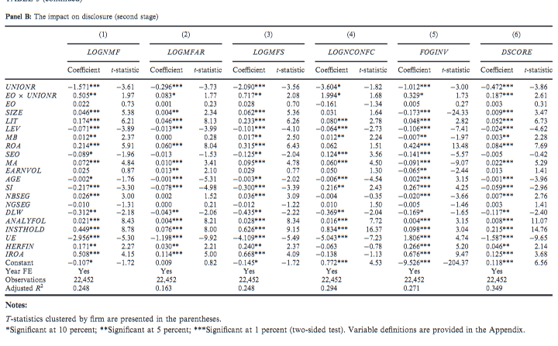

Slide 6
Aobdia, D., & Cheng, L. (2018). Unionization, product market competition, and strategic disclosure. Journal of Accounting and Economics, 65(2-3), 331-357.
We find that non-unionized firms disclose more information and more good news when renegotiations are ongoing.
This behavior is stronger for larger firms, firms with fewer peers in the industry, and firms more similar to their renegotiating rivals.
We also find some evidence that unionized firms are harmed by this behavior and that non-unionized firms benefit from their increased disclosures.

Slide 7
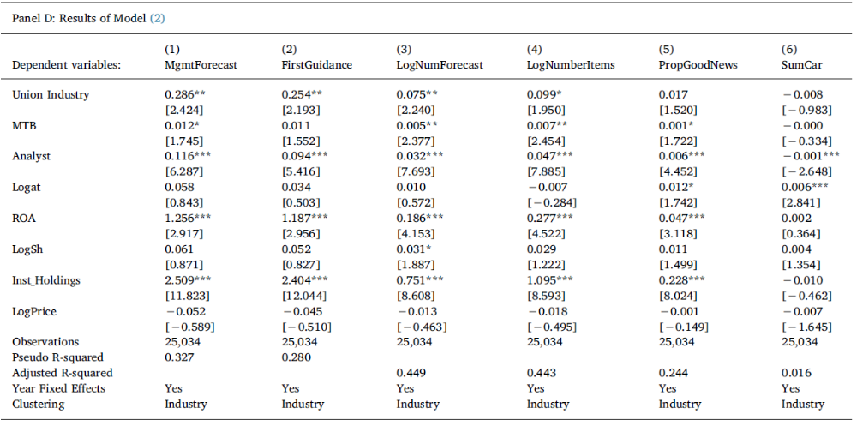

Slide 8
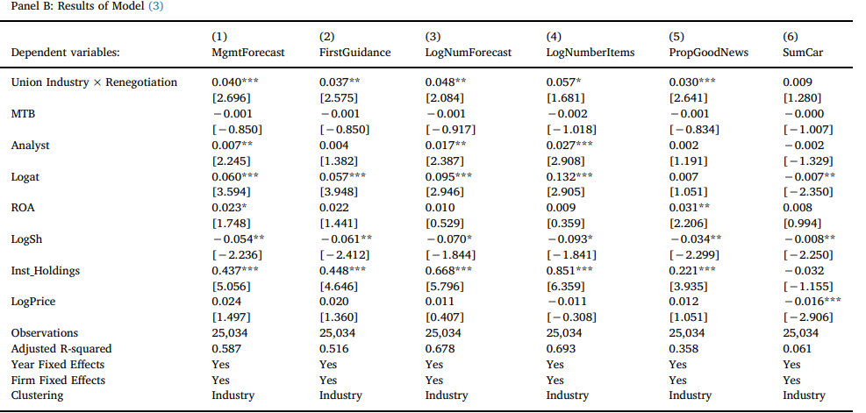

Slide 9
Proprietary Cost Caused by Attention from Regulators

Slide 10
Hope, O. K., Ma, M. S., & Thomas, W. B. (2013). Tax avoidance and geographic earnings disclosure. Journal of accounting and economics, 56(2-3), 170-189.
This study tests the relation between corporate tax avoidance and disclosure of geographic earnings for U.S. multinational companies.
We find that after the adoption of Statement of Financial Accounting Standards No. 131 in 1998, firms opting to discontinue disclosure of geographic earnings in their financial reports have lower worldwide effective tax rates.
These results are consistent with managers perceiving that non-disclosure of geographic earnings helps mask tax avoidance behavior.
However, the relation between tax avoidance and non-disclosure reduces after implementation of Schedule M-3 in the annual corporate tax filing beginning in 2004. Schedule M-3 requires a detailed reconciliation of book income to tax income and aims to make firms' tax avoidance activities associated with shifting profits to lower-tax foreign jurisdictions more apparent to the IRS.
Notes:
after implementation of SFAS 131 in December 1998, firms that define primary operating segments by industry are required to disclose only geographic sales and assets; disclosure of geographic earnings is voluntary (FASB 1997).

Slide 11
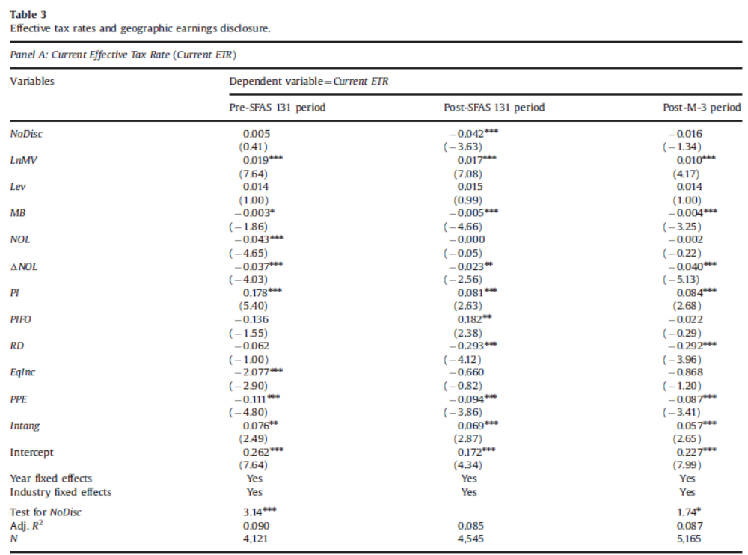

Slide 12
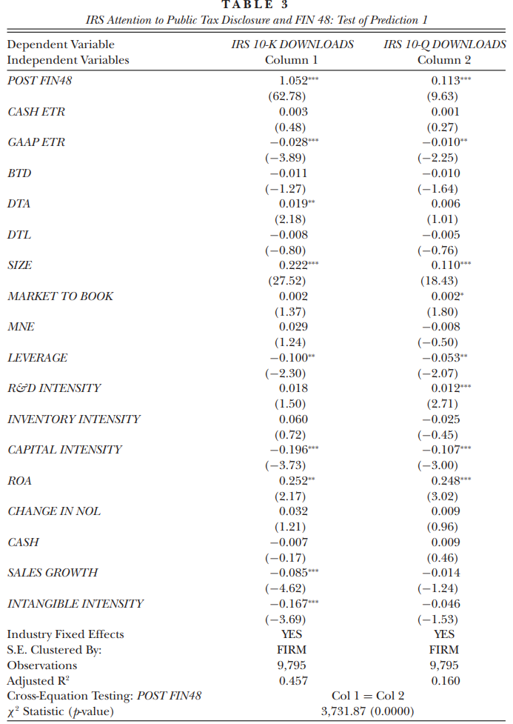
Bozanic, Z., Hoopes, J. L., Thornock, J. R., & Williams, B. M. (2017). IRS attention. Journal of Accounting Research, 55(1), 79-114.

Slide 13
Proprietary Cost Caused by Attention from the Public

Slide 14
Dyreng, S. D., Hoopes, J. L., Langetieg, P., & Wilde, J. H. (2020). Strategic subsidiary disclosure. Journal of Accounting Research, 58(3), 643-692.
We use data provided by multinational firms to the Internal Revenue Service regarding their foreign subsidiary locations to explore the accuracy of public subsidiary disclosures on Exhibit 21 of Form 10-K per SEC rules.
The overall incidence of nondisclosure is low, suggesting that most firms comply with Exhibit 21 disclosure rules, and that for most applications, Exhibit 21 disclosures provide a reasonable proxy for locations of significant subsidiaries.
Nevertheless, there is some evidence of nondisclosure, particularly when subsidiaries are in tax havens, when the firm is more highly scrutinized in the media, or when the firm has other characteristics consistent with low-quality disclosures such as SEC comment letters.

Slide 15
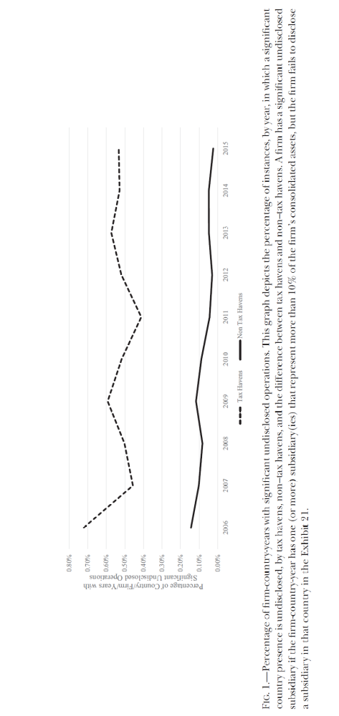

Slide 16
Week 3: Disclosure, Reporting, and Corporate Investment
Prof. Zheng Wang
AC8900
Semester A 2026/2027

Slide 17
The Effects of Financial Reporting and Disclosure on Corporate Investment: A Review
Journal of Accounting and Economics, 2019
Sugata Roychowdhury, Nemit Shroff , Rodrigo S. Verdi

Slide 18
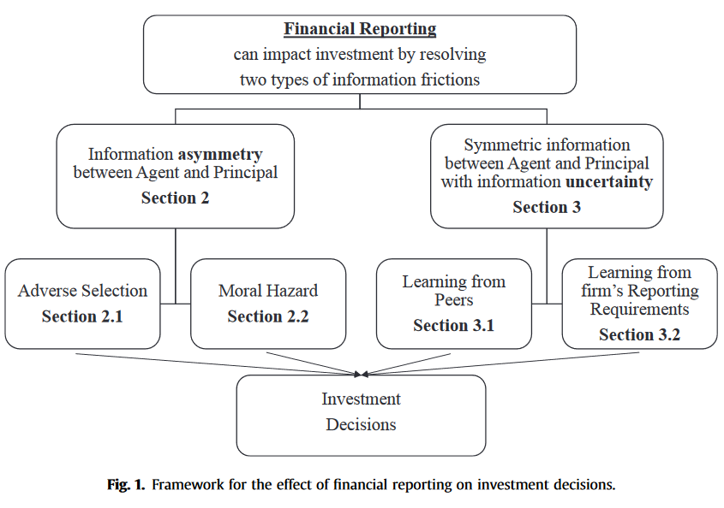
The Role of Financial Reporting in Investment Decisions/Investment Efficiency
2
02

Slide 19
Agency Framework—The adverse selection channel
3
02
Information asymmetry about firm value before the firm raises external capital for investment
Adverse selection problems between managers and investors
Improves firms’ access to external capital
-
Mitigate under-investment problem for financially constrained firms
Financial Reporting
-
Adverse selection problems among investors
Improves stock price liquidity and access to external capital

Slide 20
5
Agency Framework—The moral hazard channel
02
Information asymmetry regarding managers' actions after the firm raises capital
Manager-shareholder conflicts
Empire building
Mitigate over-investment problem
-
Financial Reporting
Monitor/incentivize
Effort aversion (quiet life)
-
Improve Investment Efficiency
-
Risk-aversion

Slide 21
Prior Studies
4
02
Biddle and Hilary (2006): Higher accounting quality is associated with lower investment-cash flow sensitivity.
Biddle et al. (2009): Higher reporting quality is associated with less under- and over-investment.
Cheng et al. (2013): The remediation of internal control weakness reduces investment inefficiency.
Naranjo et al. (2019): The adoption of IFRS leads to increased financing and investment.
Shroff (2019) finds that non-SEC registered firms audited by a PCAOB-inspected auditor increase capital expenditures following the disclosure of their auditors’ inspection reports.

Slide 22
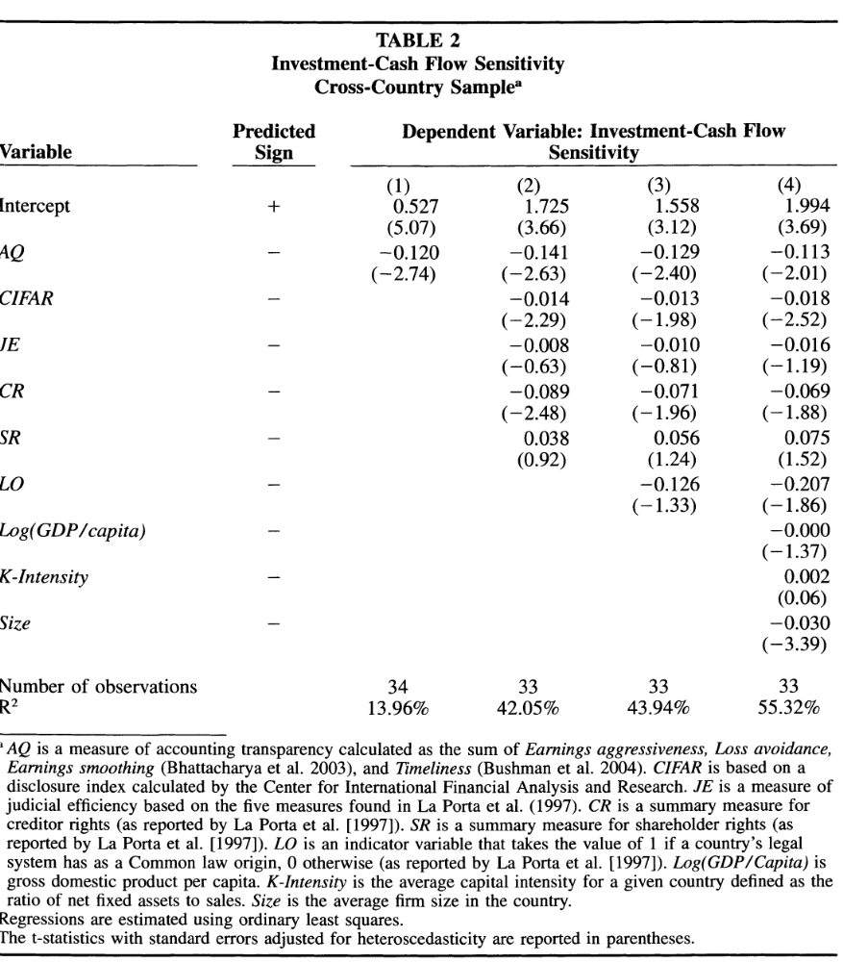

Slide 23
Prior Studies
Empire building:
  Hopes and Thomas (2008): the passage of SFAS 131 increases the likelihood of managers engaging in empire building by causing a decline in transparency about foreign operations.
  Timely recognition of loss disincentivizes managers from investing in negative NPV projects and incentivize them to more quickly divest negative NPV projects (Francis and Martin, 2010; Bushman et al., 2011)
Quiet life and risk aversion:
  Through incorporating accounting measures in compensation contracts.

Slide 24
Learning from peer disclosure:
Externality of Financial Reporting
7
Firms within a peer group (e.g., industry, geographic region, supply chain, etc.) are affected by similar economic conditions related to demand, supply, labor availability, and input costs, among other things.
If peer-firm disclosures inform managers of other firms about these economic conditions, then peer-firm disclosures can help managers make more informed investment decisions.
02
Forecast future demand and costs（ Lundholm and Sloan, 2013; Curtis et al., 2014; Chu, Kim and Wang 2019)
Improve investment efficiency
Peer-firm disclosure
Reduce uncertainty about expected future cash flows from an investment project (Bond and Van Reenen 2007; Bloom et al. 2007)
Respond faster to investment opportunities
Ex-post inefficient investment decisions
Managers have incentives to misreport performance metrics to meet financial reporting objectives (Durnev and Mangen 2009; Beatty et al. 2013)

Slide 25
Learning from a firm’s own disclosure requirements
9
02
In the presence of information acquisition and processing costs, disclosure requirements and financial reporting regulation (e.g., internal control testing) can induce firms to collect and process additional information that affect managers' information sets and thus their investment decisions.
Compliance with new financial accounting rules leads to changes in managerial accounting systems, which is the premier source of information for managers' capital budgeting decisions
Shroff (2017) finds that changes in GAAP that are more likely to require firms to collect new information as part of the compliance process have a significant effect on firms' investment decisions even in the absence of a contracting motive.
The Literature related to “Internal control weaknesses” (Cheng et al., 2013; Feng et al., 2015; Harp and Barnes, 2018)

